Slide 1
The Origin of ChatGPT: From Games to Generative AI
Presenters: Xiang BIAN
Jianye SHI

Slide 2
Plan
Conceptual Foundation (Games)
Core Technology (Transformer, Pre-training)
Key Breakthrough (RLHF)

Slide 3
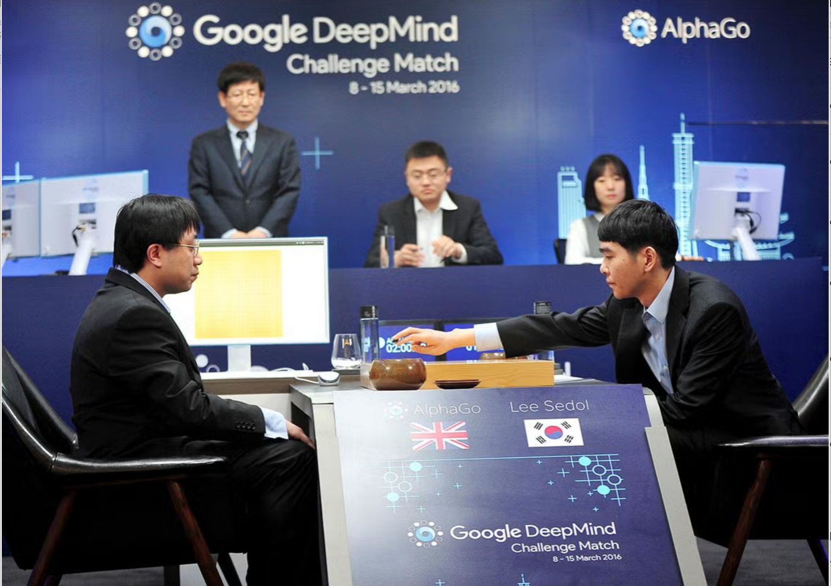
Phase 1: AI Learns Strategy (Conceptual Foundation)
AlphaGo (2016)
Defeats world champion
Game as "Small World"
Clear rules
AI can "Think"

Slide 4
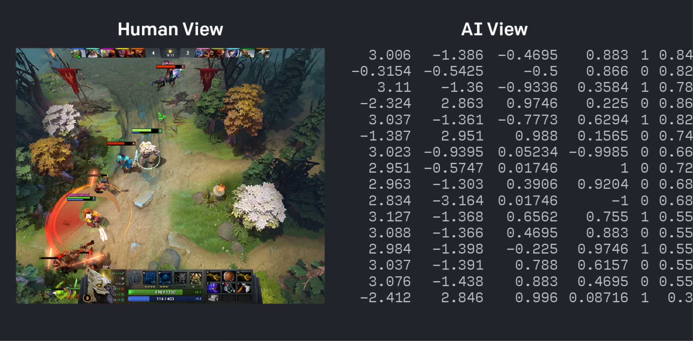
From Strategy to Language Spark
OpenAI's Dota 2 AI,
Complex team coordination,
Beats professional players,
Next Question: Can AI learn "Language"?

Slide 5
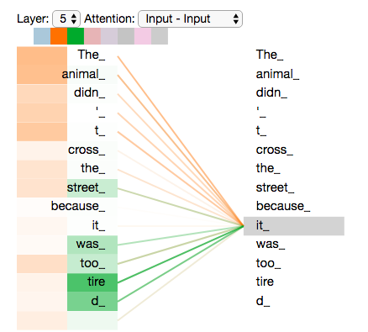
Phase 2: The Core Architecture (Transformer)
Old AI: short attention
Transformer invented
Focus on key words
Faster learning
image source https://jalammar.github.io/illustrated-transformer/

Slide 6
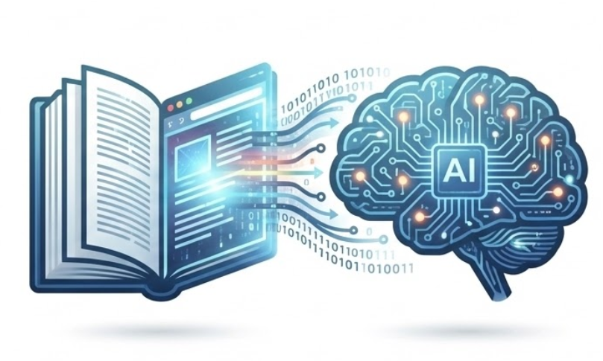
Scaling Up Knowledge (Pre-training GPT)
“Read the internet” idea
Not memorizing, finding patterns
Learn expression & reasoning
GPT-3 surprises everyone

Slide 7
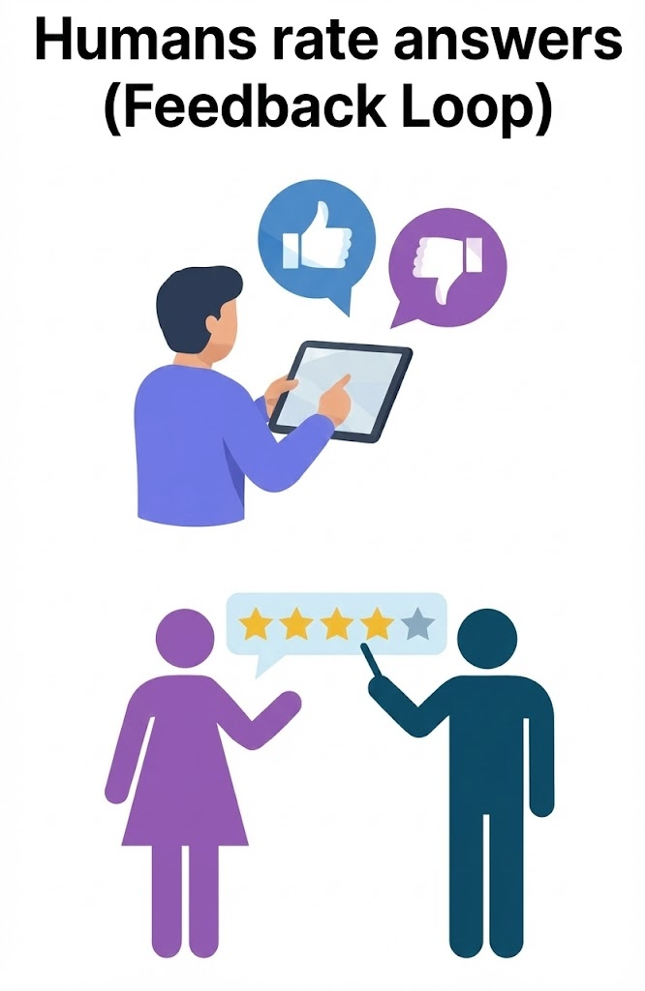
Phase 3: Making it Conversational (RLHF)
GPT-3 still “wild”
Humans rate answers
Learns clarity & politeness
Knows what people prefer
Becomes natural to talk to

Slide 8
Summary: Key Pillars of ChatGPT
Smart architecture
Large-scale training
Human-shaped behavior
Years of progress
Future built on today

Slide 9
References
Silver, D., Huang, A., Maddison, C. J., Guez, A., Sifre, L., Van Den Driessche, G., … Hassabis, D. (2016). Mastering the game of Go with deep neural networks and tree search. Nature, 529(7587), 484–489.
Vaswani, A., Shazeer, N., Parmar, N., Uszkoreit, J., Jones, L., Gomez, A. N., … Polosukhin, I. (2017). Attention is all you need. In Proceedings of the 31st International Conference on Neural Information Processing Systems (pp. 6000–6010).
Brown, T. B., Mann, B., Ryder, N., Subbiah, M., Kaplan, J., Dhariwal, P., … Amodei, D. (2020). Language models are few-shot learners. Advances in Neural Information Processing Systems, 33, 1877–1901.
Bai, Y., Jones, A., Ndousse, K., Askell, A., Chen, A., DasSarma, N., … Kaplan, J. (2022). Training a helpful and harmless assistant with reinforcement learning from human feedback. arXiv:2204.05862.
Ouyang, L., Wu, J., Jiang, X., Almeida, D., Wainwright, C., Mishkin, P., … Lowe, R. (2022). Training language models to follow instructions with human feedback. arXiv:2203.02155.

Slide 10
Thank You

